Slide 1

IMS Project Group A6
Giulia Baldini, Emanuela Calabi, Mikel Grabocka
29/11/2017

Slide 2
Technologies used
Bootstrap
HTML
CSS
Javascript
PHP
MySQL

Slide 3
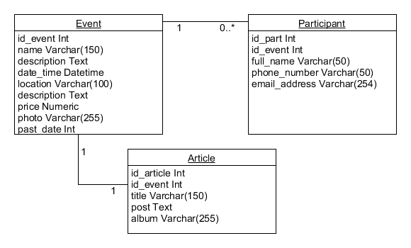
Database

Slide 4
Estimated Effort
Goal: fully working website
1/4 planning
2/4 implementation ~130h
1/4 testing & documentation

Slide 5

Wireframes and First Look

Slide 6
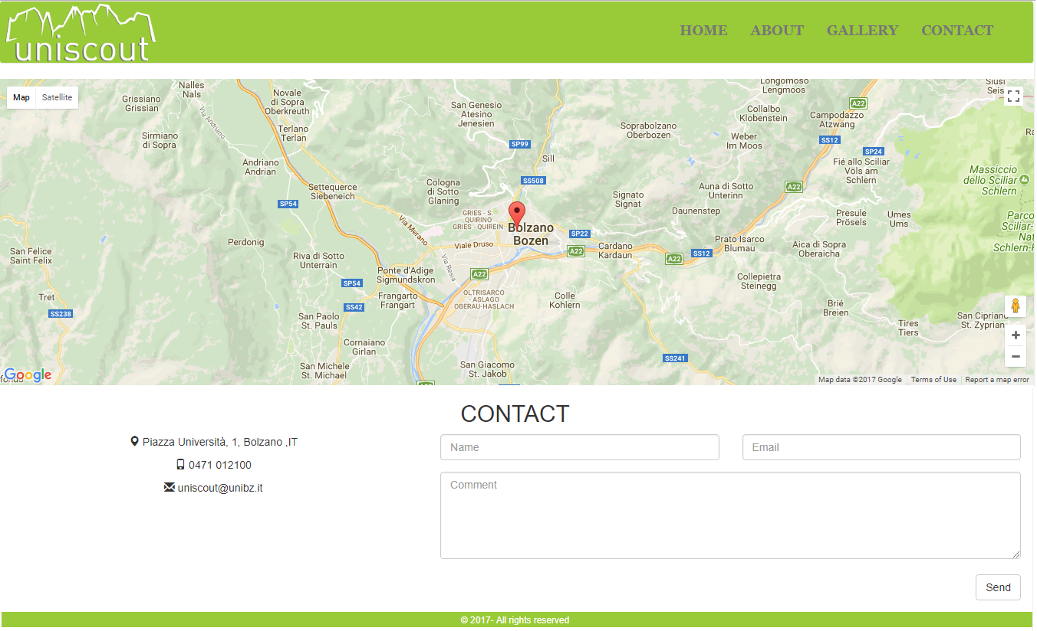
Wireframes and First Look

Slide 7
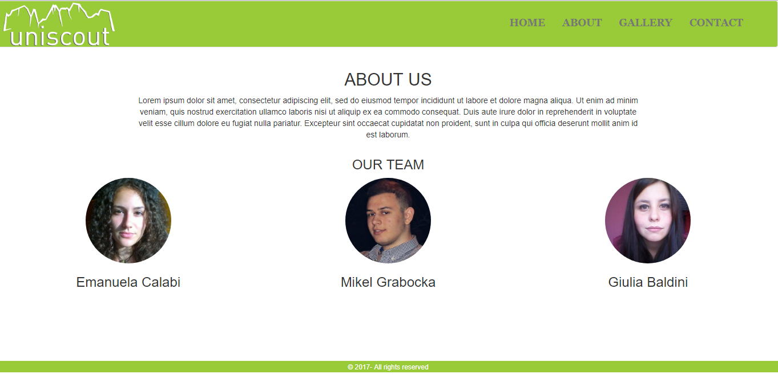
Wireframes and First Look

Slide 8
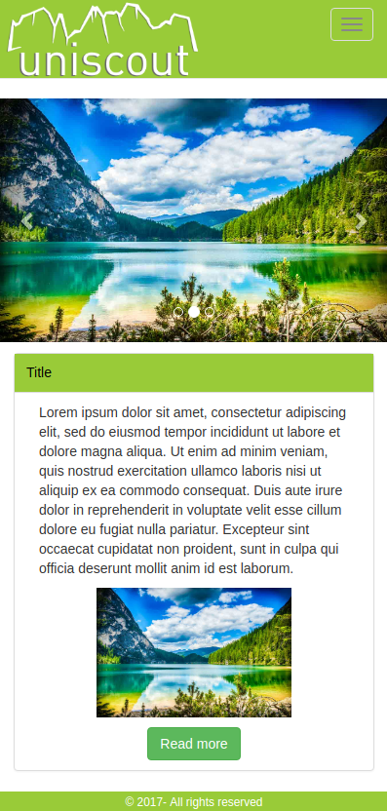
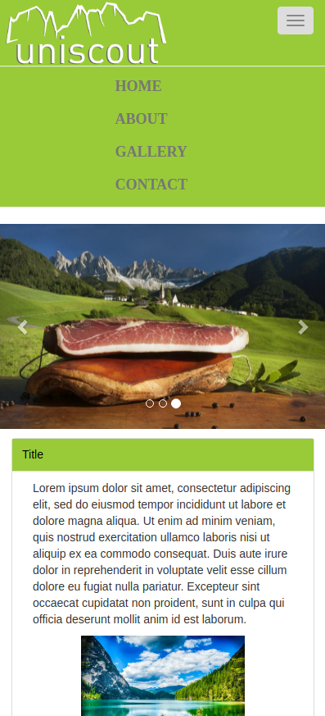
Mobile Version

Slide 9
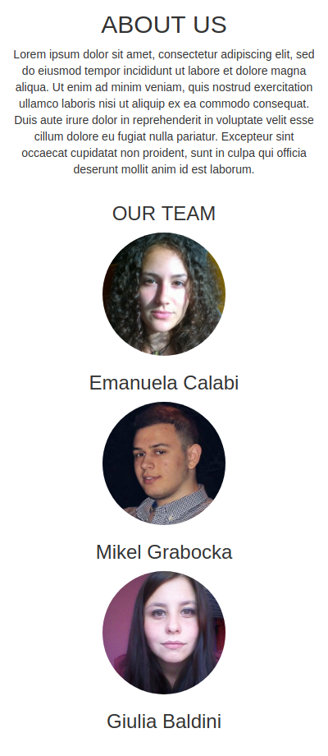
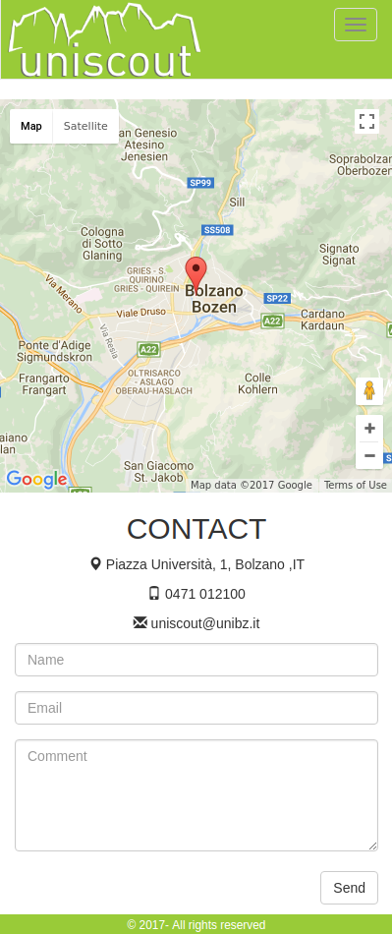
Mobile Version

Slide 10
Thank you for your attention

